Slide 1

Republic of Serbia
Fiscal Council
2015 – 2017 FISCAL STRATEGY ASSESSMENT AND SIGNIFICANCE OF PUBLIC INVESTMENTS FOR ECONOMIC GROWTH
11 February 2015

Slide 2
Fiscal Strategy: painful, though adequate measures
A demanding multi-year plan for public finances recovery and public sector reforms
  It shows Government’s clear intention to start addressing accumulated problems in public finances
  It envisages difficult and painful cuts (reforms and discharging employees in public companies, administration, health care and education systems, as well as wage and pension freeze, restructuring process completion etc.)
  Major professional, political, but social challenges as well
Fiscal Council finds that savings measures are adequate
  Due to the magnitude of the problem, there is no actual alternative to severe savings measures
  No resolute deficit reduction would mean explosion of public debt and certain fiscal crisis: deep GDP decline, strong Dinar weakening and high inflation
Basis for concluding a three-year arrangement with IMF
  Significantly improves the prospects for the entire programme success

Slide 3
Ambitious multi-year plan – implies risks
Fiscal consolidation will have to include 2018 as well: a four-year plan instead of a three-year one is necessary
  Fiscal deficit reduction to 3.8% of GDP is not enough for public debt stabilization by 2017
  Additional deficit reduction by 1 p.p. of GDP in 2018 is necessary
Two crucial reform blocks carry the greatest risks
  Public and state-owned companies: putting the operation of Srbijagas, EPS, Železnice in order, resolving the fate of Železara Smederevo, Petrochemical Complex
  Public (budget) sector: reduction of employees number along with all-encompassing reforms
  Deadlines are short (couple of months), but precise plans are still not in place
Sharp reversal in fiscal policy, while economy is in recession
  Unfavourable macroeconomic environment significantly aggravates necessary implementation of fiscal consolidation
  Macroeconomic policy measures are necessary for economic growth incentive

Slide 4
Public investments are the best antirecessionary measure
Serbia’s economy has been in recession since 2014 – economic activity decline by app. 1.7%
  Savings measures will have a temporary negative effect on economic growth and will deepen the current recession
  Prolonged and uncontrolled recession can endanger fiscal consolidation
Government investments in infrastructure may alleviate negative effect of consolidation on the economic growth
  In a short-term, the effect of public investments on economic growth (fiscal multiplier) is at least twice bigger than other forms of government spending
    Negative effect on economic growth due to a deficit/spending reduction by 2 p.p. of GDP can be offset by increasing investments by 1 p.p. of GDP
  In a medium-term, the improvement of road and railroad infrastructure as well as of energy capacities will create conditions for a faster economic growth

Slide 5
Poor infrastructure condition requires an investment growth
General state of infrastructure is alarmingly poor - Serbia is among the worst rated countries in international rating lists
  According to overall infrastructure quality, Serbia is ranked as 111st out of a total of 148 countries – the worst in the region
  By road quality it is 114th (only Romania is rated worse in the region)
Budget allocations for public investments are undoubtedly low – only 2.5% of GDP in 2014
  They need to be doubled – public investments in the comparable countries of Central and East Europe amount to more than 4% of GDP at an average
Adequate projects and financing sources exist
  The projects to improve infrastructure quality exist (eg. road and railroad Corridor 10)
  Financing for infrastructure projects has been ensured on preferential terms– loans by the World Bank, EIB, EBRD with log repayment period and low interest rate

Slide 6
Public investment growth is justified even at the cost of a slightly higher deficit
Public investments can be increased in 2015 by 1 p.p. of GDP through more efficient implementation of current projects
  Fiscal Strategy plans only 0.5 p.p. increase, which is not enough
  An important stimulus for domestic economic activity
Ideally, the room for somewhat bigger growth of investments should be found in the planned budget framework
  By reducing other, less productive expenditures, like subsidies
If this is not possible, even a smaller deficit reduction would be acceptable if the reason was a stronger investment growth
  Due to a strong positive effect on the economic growth, the increase in capital expenditures will affect the deficit less as compared to all other public expenditures
  New borrowings are not necessary for financing an additional increase in public investments – the funds have already been approved

Slide 7
Public and state-owned companies:
The need for significant reforms
Resolving the accumulated problems of public and state-owned companies is a key reform move for the Government – we support that
  This will not yield the biggest savings; however, if their operations are not put under control in 2015, a complete cave-in of public finances is possible
  Much more important – reform should ensure that public companies be the boosters of economic growth
    Instead of being loss-makers and social institutions
Resolving the status of companies under restructuring = eliminating the “parasite sector”
  Many companies with no perspective, however, have been draining huge funds from the economy and budget for years
There are chances for this to end
  First concrete steps are visible: liquidation of 188 companies under restructuring, changes in the EPS, privatization of Železara Smederevo?

Slide 8
Public and state-owned companies:
Complex problems, yet short deadlines
The Government has implicitly committed to addressing the biggest problems already in the first half of 2015 – very uncertain
  No budget funds for the Srbijagas in 2015 means resolving the fate of the biggest gas debtors even by mid year (Železara, Petrohemija, Azotara, MSK)
  Železara Smederevo is a problem per se - facing closing without Esmark?
  Lower subsidies for the Železnice in the budget - is this sustainable without a plan for employee discharging and rationalization of services?
  There is a real danger for the EPS’ losses to be transferred to the government – the biggest problems must be resolved without delay (redundant employees, poor collection, low price etc.)
Detailed plans are still not in place, whilst the first deadlines have already been breached – February?

Slide 9
Decrease in the number of employees without detailed plans is a big risk
Fiscal Strategy envisages successive decreases in the budget sector employment of 5% per year by 2017
  According to the plan, in three years the health care and education systems, as well as state and local administration, should have 15% less employees (app. 75.000)
Such a big decrease in the number of employees cannot be achieved by natural outflow only – neither this would be desirable
  Natural outflow through retirement of employees with a limited filling in the vacant posts can only ensure one half of the planned employment decrease
  This is also an uncontrollable process – both the redundant employees and the ones that are necessary retire
  Detailed plans, detailed sector analyses and discharging criteria are crucial for a successful rationalization of the number of employees – those are still not in place
Employment rationalization must be accompanied by fundamental reforms of the biggest government systems – health care and education
  Risks are substantial—detailed reform plans are needed which would ensure that the quality of services is at least maintained in these sectors despite the smaller number of employees

Slide 10
Risks are substantial, yet there are no contingency measures
Public companies reform and employment rationalization carry numerous challenges – savings might be lower than planned
  The implementation is challenging both politically and professionally – delays are possible and it can jeopardize the entire fiscal consolidation
The Government must have contingency measures prepared upfront, to become automatically effective if fiscal goals are not achieved
  The credibility of the programme would be stepped-up with the investors and creditors – the Government would guarantee reaching the basic fiscal goals
  Presenting contingency measures in the Fiscal Strategy would make a timely public debate possible, while the ad hoc solutions would be avoided
A stringent, and a de facto four-year, fiscal consolidation programme is not possible without the IMF arrangement
  Systematic monitoring of the implementation of measures would significantly lower the risk of “skidding”, giving up and failure of the programme. Only the IMF arrangement can provide for the international credibility of the programme - an increasing debt for at least three more years is not credible for the creditors

Slide 11
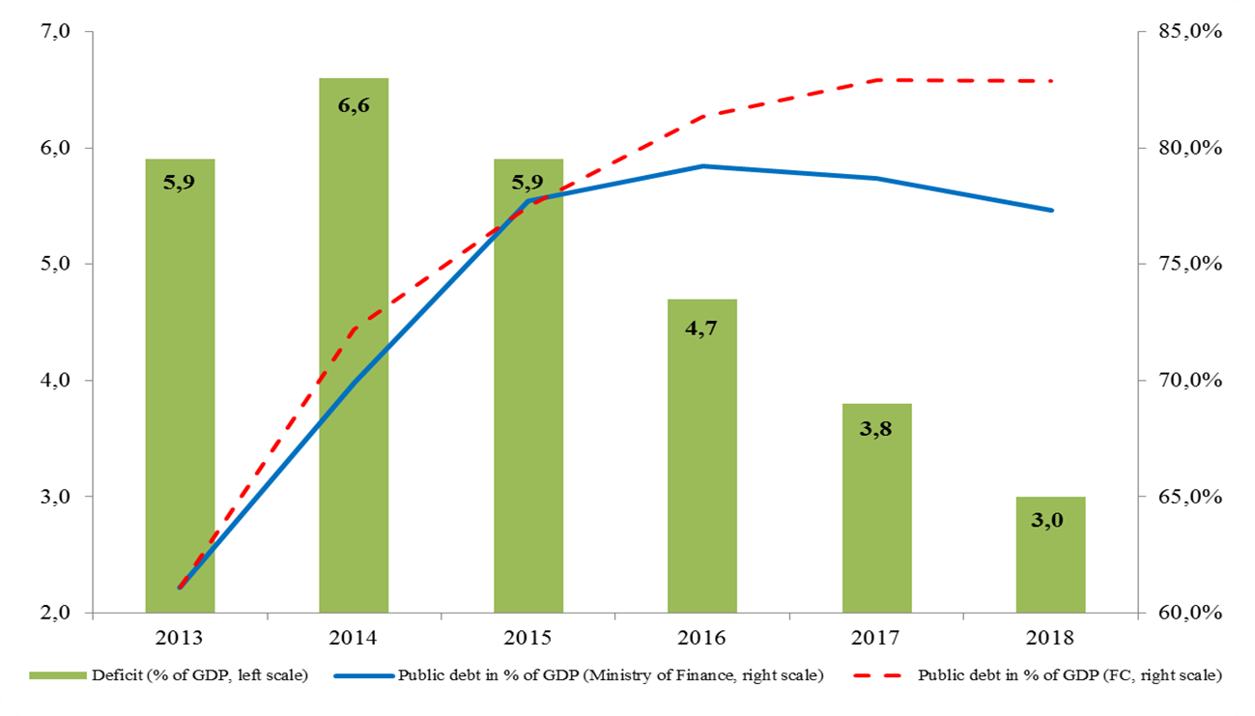
Public debt stabilization
Additional measures and deficit reduction below 3% of GDP in 2018

Slide 12
Government’s assumptions
Real Dinar appreciation
  This is optimistic (key difference)
  FC assumes unchanged real exchange rate
GDP growth-0.5%, 1.5% and 2% during 2015-2017
  GDP is realistic for 2015, overrated for 2016 (0%)
  Growth of 2% in 2017 is possible only with investment increase
Moderate interest rates increase
  Adequate projection
Possible additional risks
  A more significant increase in interest rates, protracted recession, realistic Dinar depreciation

Slide 13
Public debt management
A 2 billion Dollar debt converted to Euro in 2003
  Dollar depreciation 25%
  Exchange rate loss ~ 300 million Euro
Since 2011 we have been borrowing through Dollar Eurobonds, without insurance against FX risk
  Dollar appreciated over 10% during 2014
  Public debt increased by 500 million Euro
  Interest expenditures in 2015 increased ~ 8 billion Dinars
Conclusion: Serbia has no consistent borrowing strategy
  FX losses are unnecessarily endured

Slide 14
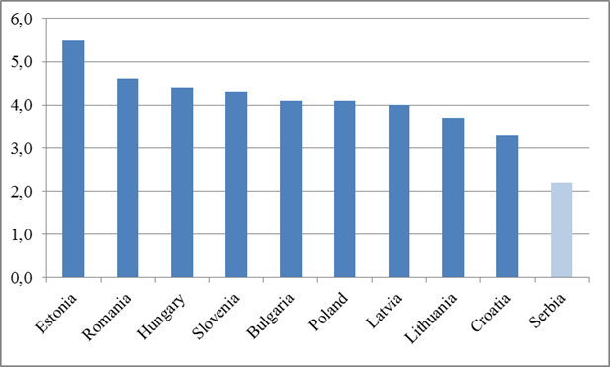
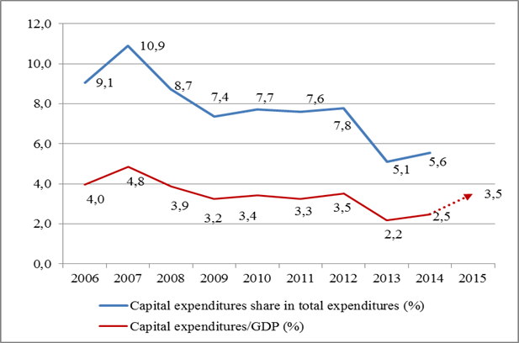
Serbia is lagging behind in infrastructure investments
Relative to comparable countries, Serbia has the lowest level of public investments (2.5% against 4.5% of GDP)
Public investments in Serbia are decreasing, both relative to GDP and the total public expenditures (2005-2014, %)

Slide 15
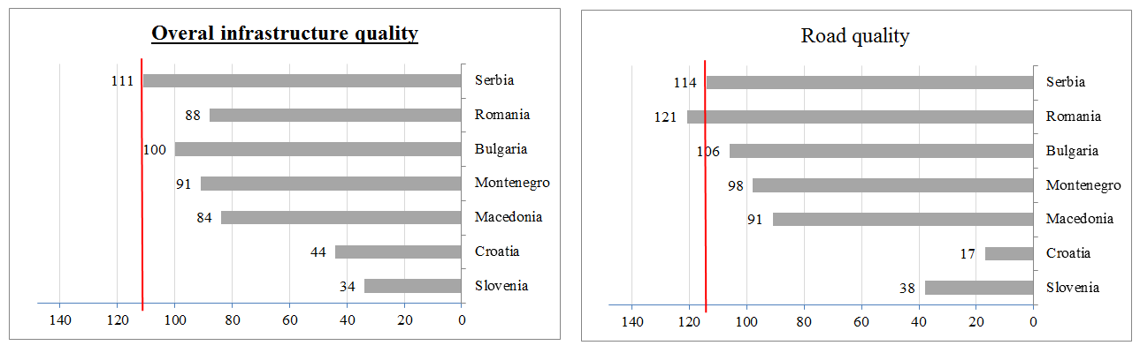
The current state of infrastructure does not allow for postponing the investments
(Source: World Economic Forum)
Serbia is the worst in the region by infrastructure (111st position out of 148; Slovenia is the 34th and Croatia the 44th)
Since 2008 an average of 30 km of highway has been constructed per year (50 km in Croatia). Only 10 km was constructed in 2012
Average train speed is 40 km/h (55% of the tracks are from the 19th century)

Slide 16
The funds are available but not withdrawn
App. 5 billion Euro has been approved for current infrastructure projects of the government and public companies, out of which 3.7 billion Euro remains not withdrawn (11% of GDP)

Slide 17
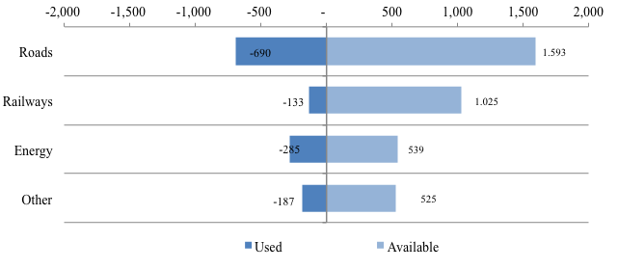
Most unwithdrawn loans are in the road infrastructure sector
If new, certain loans are also included (EXIM bank loan for Kostolac), another 500 million will be received in 2015; With Belgrade-Budapest railroad, UAE…the numbers grow further
On average 20% of the planned (budgeted) investments are not executed each year
  Important: a decrease in public investments is not part of the targeted savings, it is a consequence of non-executed plans
Our estimate is that the value of the currently delayed projects amounts to over 1 billion Euro
  Due to delays in withdrawing approved funds for infrastructure, Serbia pays yearly penalties of app. 4 million Euro

Slide 18
Realistic increase in public investments in 2015 is app. 1% of GDP
An increase of 1% (1.5% with public companies) is only possible along with a significant increase in investing efficiency
If all planned infrastructure projects were implemented in time (hardly achievable), the increase in budget investments in 2015 would amount to 1.3% of GDP (2.5% with public companies)

Slide 19
A possible increase in investments in roads is app. 313 million
Corridor 10: with current deadlines the increase of app. 130 million Euro (750 available);
Corridor 11: assuming the same dynamics in the sections the work on which is underway; uncertain launching of the new ones;
Projects for road reconstruction and safety: execution estimate is app. 56 million Euro in 2015 (project launching);
The Sava bridge: remaining 83 million Euro must be used in 2015 due to withdrawal deadline; there was no execution in 2014;
Belgrade bypasses: expected increase of 44 million Euro

Slide 20
Investments in the railroads may increase by app. 251 million
The second railroad track of the Pancevo bridge to Pancevo town section and reconstruction of a section of the Corridor 10 track (112 km) : 44 million Euro in 2015
The beginning of the works on the Stara Pazova-Novi Sad railroad track and the reconstruction of the Belgrade-Vrbnica (Bar) railroad track : 170 million in 2015
The Prokop railroad station: 26 million
The purchase of the railroad vehicles: increase of 11 million (from two loans)
It is not certain if the reconstruction of the railroad Corridor 10 will begin in 2015–project is being redone, while the elaboration of technical documentation is progressing slowly

Slide 21
131 million in the energy sector
Long postponed purchase of the electricity meters – 78 million Euro
HPP Zvornik: a dispute with the bidder is resolved, 9 million increase
Construction of 32 small hydro power plants – 11 million
Kostolac TPP (terminals and railroad infrastructure)– 13 million
Kostolac Desulphurization factory – 53 million
Kolubara coal homogenization improvement – 18 million
Kostolac: the 1st phase completion decreases investments by 59 million (the 2nd phase launching may increase by 100 million)

Slide 22
Another 125 million in other areas
Investment works in the flood damage recovery– 60 million
Belgrade, Novi Sad, Kragujevac clinical centers– 40 million
Municipal water supply improvement - 25 million

Slide 23
Reasons for low public investments
There are failures at all levels and at all stages of implementation
  From the ministries, over state-owned companies in charge of organizing the performance of infrastructure works, designers, to contracting companies
Ill-defined responsibilities even at the level of ministries, lack of coordination and cooperation
  The Žeželj bridge or the Pancevo water supply, for example,
The capacities of the government bodies and companies in charge of infrastructure managing and exploitation are insufficient for selecting, implementing, supervising and evaluating undertaken investments
Adequate feasibility studies are lacking, while a project selection decision is often based on the political influence
  Priority selection is often guided by the reasons other than the needs of society
  Large projects are being announced without their profitability being verified by adequate studies. For some of them not even the exact role of and expense of the government is clear
  Administrative hindrances stand in place of a substantial profitability analysis
Frequent delays, as well as numerous errors in the technical documentation and financial calculations are obvious in the project elaborations
  According to the assessment of the Ministry of Construction, Transport and Infrastructure , the damage caused by the “low quality projects” in the area of roads and transportation safety is estimated to 100 million Euro
Inefficient issuing of construction and utilization permits, as well as expropriation process

Slide 24
Recommendations
Public investments should be institutionalized as a priority
Responsibility for public investments must be firmly and hierarchically established, starting from the Government level:
  A dedicated operational sector for execution of capital investments, like the ones in UK or Australia
Ministries and ministers must be held accountable before the Government, and thus act as direct as agents securing efficient investments
A three-year plan of public investments should be made, accompanied by more detailed annual plans
  Capital expenditures in the Budget and Fiscal Strategy are not accounted properly (there is only a declarative support for their increase)
Ministry of Finance must have more saying in early stages of project development, and accordingly its capacities must be strengthened
Concessions (transport), other PPPs and private investments (energy) should be utilized where appropriate
Special attention must be paid on characteristics of individual projects, namely on the agreed financial and construction/execution terms
  Imports of goods and services (even labor force) decrease benefits for the local economy

