Slide 1
Republic of Serbia
Fiscal Council
ASSESSMENT OF BUDGET REBALANCE, STRUCTURAL REFORMS PROPOSAL AND FUTURE FISCAL TRENDS
July 4, 2013

Slide 2
Basic assessments of the new Government program
Structural reforms – a step forward towards permanent recovery of public finances
Pension reform missing
Budget rebalance – coerced, good direction, in general
However, the Republic budget could exceed the planned one (5.3% of GDP instead of 4.7% of GDP)…
…along with the local level, funds, Roads of Serbia (state level), about 6% of GDP
There is still no credible plan for deficit reduction in 2014
Low pensions and wages indexation is a good step, but insufficient
Without additional measures, the public debt would continue growing in the following three years – unsustainable

Slide 3
Deciding upon the fate of enterprises undergoing restructuring
€ 700 million – 1 billion at state expense annually
To a smaller scale, these are direct budget expenditure, but – they do not pay taxes or settle liabilities to public enterprises or businesses
The plan is developed, deadlines defined for different cases, funds included in the budget
Substantial progress in comparison to the Fiscal Strategy
It will not be painless – approximately 60,000 employees
It will incur costs in 2013 and 2014, but, in the medium run, it will bring fiscal savings and increase in the efficiency of economy
The most difficult issues postponed for 2014 (IMR, 14. Oktobar, FAP, Prva petoletka… ) – challenging

Slide 4
Upgrade of public enterprises operations
Strategic partnership between JAT and Etihad – an excellent opportunity
It will cost – the state will probably assume JAT debts (around € 250 million), but the state would repay them anyway
Galenika and Dunav Insurance (Dunav osiguranje) – restructuring and privatisation are justified
Reduction of subsidies for Serbian Railroads (Železnice Srbije) and Resavica (privatisation)
The highest direct budget subsidies – we support the reduction, but we cannot see the plan for that
Srbijagas – the biggest problem (in 2012, unprecedented losses – €300 million)
The state assumes debt repayment – a huge debt (€800 million)
Government program – no more guarantees to cover borrowing for solvency purposes – excellent step, but unlikely
Urgent restructuring is necessary

Slide 5
Rationalisation of the number of employees
Surplus of public sector employees – administration (local level in particular), health care system, school system
Studies made in the past indicate at least 20,000 employees extra
Systemic solution is a must
Voluntary leaves with redundancy pay and ad hoc rationalisation had no effect in the past
Now, all necessary steps are being planned:
Amendment to the laws regulating public sector employment (until the end of the third quarter)
Development of sector plans for employees layoffs
Creation of operational preconditions (single registry)
Problems may arise (pressure of trade unions, interest groups), but one should persist

Slide 6
Abandoning pension reform is undermining the program credibility
In 2012, the Government adopted the Fiscal Strategy according to which the pension reform should be launched in the first half of 2013
Actuarial penalties, reappraisal of accelerated service (without necessary reduction of the gap between men and women retirement age)
Not only it has not been launched, but it is not included in the new measures package either
Without it, the public sector reform is unlikely
It raises the issue of what will happen with the new package once true resistance to it is met
A law prescribing the vacancy announcements for the managers of public enterprises until June 31, 2013 – facing enforcement problems already
Layoffs, loss of privileges, gas price increase, etc. are yet to follow...

Slide 7
At least €350 million missing in 2014
Wages and pensions control (increase of 0.5% in October 2013, 0.5% in April 2014 and 1.5% in October 2014) is a good measure
It provides for the savings of 1% of GDP in 2014
But the allocations for interest rates will be increased by around 0.4% of GDP (public debt and interest rates are growing)
And “eat up” almost half the savings amount
With the current Government measures, deficit reduction in 2014 will record 1.2% of GDP at most
With additional effects of already adopted changes in profit tax, contribution and income tax and higher tax collection rate (0.5-0.6% of GDP)
We think there are still at least 1% of GDP of savings missing (around €350 million) in 2014 to make public finances sustainable
It must be a strong measure (equal to the effect of wages and pensions control)

Slide 8
Growing allocations for interest payments pose a great problem
Allocations for interest payments are growing exponentially – they will reach €1 billion in 2014
State allocations for agriculture amount to €400 million, €500 million for the army
Should the public debt keep growing, annual allocations for interest payments may easily grow faster than the savings – a path leading to crisis

Slide 9
Why is there 1% of GDP missing in 2014? /1
Even if the Government plans are realised (deficit of 5.2% of GDP in 2013) – without new measures, public debt would not be decreased until 2017

Slide 10
Why is there 1% of GDP missing in 2014? /2
With a somewhat more realistic scenario (deficit of around 6% of GDP in 2013) – public debt growth would not even slow down considerably
Not even an economic growth exceeding 2% in 2013 would change the path (agriculture – temporary effect)

Slide 11
Possible solution – temporary solidarity tax
Adjustment burden to be borne by the richest
Not one person with a salary or pension below the average would be affected by the decrease
It may bring over 0.6% of GDP in 2014
Application of solidarity tax to pensions |  |  | Application of solidarity tax to wages
Amount prior to taxing (in RSD) | Tax amount (in RSD) | Amount after taxing (in RSD) | Amount prior to taxing (in RSD) | Tax amount (in RSD) | Amount after taxing (in RSD)
15 000 | 0 | 15 000 | 30 000 | 0 | 30 000
25 000 | 0 | 25 000 | 40 000 | 0 | 40 000
30 000 | 500 | 29 500 | 50 000 | 1 000 | 49 000
70 000 | 4 500 | 65 500 | 100 000 | 6 000 | 94 000
110 000 | 9 500 | 101 500 | 150 000 | 11 000 | 139 000
It would affect the whole public sector, including public enterprises and independent institutions (Fiscal Council, National Bank of Serbia, State Audit Institution…)

Slide 12
Public debt reduction without deficit decrease is out of question
Public debt grew in the last three quarters by €3.5 billion
At the moment, it amounts to 62% of GDP (the right methodology)
It may be decreased temporarily, but then the liabilities would be financed by state deposit reduction (May 2013)
It is commonplace, it already happened in 2012
There are also additional risks which may lead to uncontrolled debt
Currency risk – RSD depreciation would increase the public debt (which is largely foreign currencies debt) substantially
International borrowing conditions are deteriorating, evermore for Serbia
Only deficit decrease can bring the public debt reduction, prevent high growth of interest rates and avoid crisis

Slide 13
Data for June must be interpreted with more caution
According to the Government statements, the Republic budget in June was all-time low – lower than RSD 5 billion
Excise revenues are growing strongly
Cigarette reserves kept because of Croatia EU accession?
Some expenditures suspended because of the forthcoming rebalance
Unusually low expenditures for goods and services
If only the deficit reduction was the result of Government efforts, but similar unjustified claims have already been made
In order to make a reliable assessment, data for July should be available, too

Slide 14
Budget rebalance for 2013
The decision to adopt the rebalance was right
Budget deficit amounted to 94 billion in only five months (RSD 122 billion was planned for the whole year)
Great failure in public revenues in comparison to the plan is acknowledged
The commitment to reduce expenditures is also an appropriate one
Increase in tax rates would be counterproductive in economic and budget terms
Rebalance is not fully adequate – optimistic planning of revenues and savings
This is why the deficit could reach around RSD 200 billion instead of the planned 178 billion

Slide 15
Budget rebalance revenues
The main reason for rebalance – revenues failure, although they exceed the last year level
Planned optimistically in 2013 budget (profit tax, non-tax revenues, VAT)
Change in macroeconomic environment (lower inflation, lower VAT)
Increased tax evasion level
Rebalance revenues optimistically planned, although they amount to approximately 92 billion lower than the revenues amount planned in the budget
We indicated this risks on time

Slide 16
In our opinion, the revenues will be about RSD 15 billion lower than those planned in the rebalance
The biggest discrepancies are with excises and VAT
They may also occur with profit tax, income tax and customs duties
Higher tax collection rate and better financial discipline are needed
But, in the short term, it cannot provide sufficient increase in public revenues

Slide 17
Budget rebalance expenditures
Without the rebalance, total expenditures in 2013 would be close to the planned ones
Expenditures were reduced in the budget rebalance by about RSD 36 billion in comparison to the budget
Some expenditures were increased in the rebalance…
Combination of bad planning and new policies
Interest rates for Srbijagas, Transition Fund, Radio Television of Serbia, recycling
... while some of them were decreased
Transfers to the Pension and Disability Insurance Fund, investments, subsidies, services, travel costs

Slide 18
We estimate that the expenditures will be around RSD 10 billion higher than those planned in the rebalance
The rebalance reduces agricultural subsidies
Liabilities are high – maybe even overstepping the formerly planned funds
Disbursement of agricultural subsidies for 2013 in 2014?
Reduction of subsidies to “Serbian Railroads” (“Železnice Srbije”)
They are used for disbursement of wages; possible pressures?
Is it possible to reduce expenditures for commodity reserves?
Expenditures for Pension and Disability Insurance Fund, interest rates and budget credits may be underestimated
The risk of transferring expenditure to next year is growing
In that case, there are no true savings

Slide 19
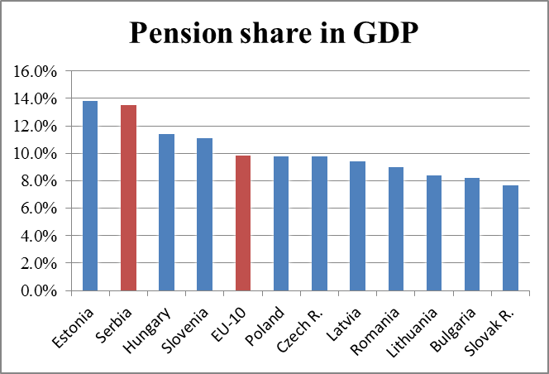
Pension reform is missing

Slide 20
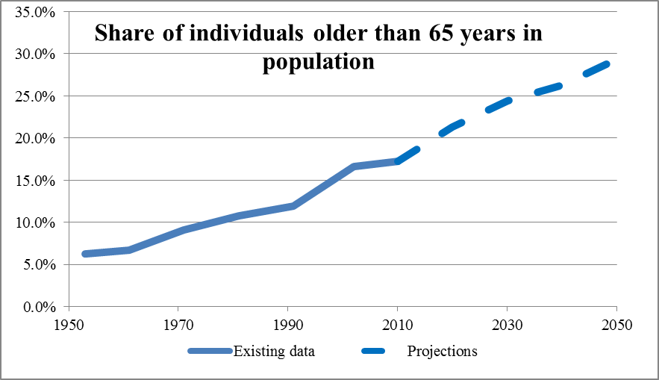
Pension reform is missing

Slide 21
Aging and depopulation
Pension reform was not adequately harmonised with demographic aging in the period 1961-2011
Life span has been increased by 8 years, from 66 to 74
Fertility rate has been reduced from 2.1 to 1.4 births per woman
It requires postponed retirement and/or lower pensions
Distinct aging and depopulation are yet to come
In 2050, 5.2 million people will live Serbia
In case economic transition proves to be successful and Serbia becomes attractive to immigrants
The share of people older than 65 years in the total population will increase from 17% to 21% in 2020 and 30% in 2050
A smaller number of people fit for work support the ever growing number of the elderly

Slide 22
Inevitability of the pension reform
Aging is distinct in the whole Europe
Economic problems worsen the situation in Serbia additionally
Pension reform is planned for the several decades term
The further they are postponed, the more painful they get
In 2002, we had to increase the retirement age limit “overnight” - by 3 years
Two extraordinary increases in pensions in 2008 permanently destabilised the system
In 2008, pensions were increased by 21% realistically (over the inflation level)
By the end of this decade we will not reach the sustainable level of expenditures for pensions prescribed by the law of 10% of GDP

Slide 23
Pension reforms measures
Destimulation of early retirement
70% of men and 50% of women retire before the regular age limit
If the pension disbursement period is prolonged, the pension amount must be properly reduced
Possibilities to extend the age limit
The 5 years’ age difference for men and women in Serbia is the highest retirement gap in Europe
Inappropriate and unfair scope of jobs eligible to accelerated service

